Slide 1


PHARMACEUTICAL INVENTORY ANALYSIS ~Deeksha Saini Project _team_233

Slide 2
Contents
Business Problem
Business Objective & Constraints
Data Collection, Project Overview and Scope
Project Architecture - Data Flow Diagram
Data Dictionary
Exploratory Data Analysis
Data Preprocessing
Data Visualization
Notes:
Change

Slide 3
Business Problem
The absence of strategic procurement for raw materials has caused overpayment and inefficiencies. Surplus inventory remains unutilized, wasting valuable resources and storage space. This highlights poor cost management and a lack of planning in resource acquisition. A systematic approach is essential to optimize costs and improve inventory control.

Slide 4
BUSINESS OBJECTIVE & CONSTRAINT
OBJECTIVE : The objective of this Pharmaceutical Inventory Analysis Project is to optimize inventory management by analyzing procurement investments, minimizing wastage, and ensuring efficient utilization of unutilized stock. This aims to improve cost-efficiency, streamline operations, and support better decision-making for sustainable financial performance.
CONSTRAINT : Focus on maximizing the utilization of current stock to minimize waste and reduce additional procurement costs.

Slide 5
Data Collection, Project Overview and Scope
Data Collection : Dataset is provided by the client end.
A Pharmaceutical Inventory Analysis Project focuses on evaluating inventory investments and ensuring efficient utilization of resources to minimize unutilized stocks and enhance financial efficiency. In this project, I used MySQL and Python to analyze the dataset, leveraging functions such as aggregations, group by, and where conditions to calculate the expenditure on procuring materials and identify unutilized stock. Key insights included identifying spending trends, areas of overspending, and strategies to ensure unutilized inventory is effectively utilized. I utilized Power BI, Tableau and Advanced Excel to create visualizations that clearly presented these insights, making the analysis actionable and the presentation engaging.

Slide 6
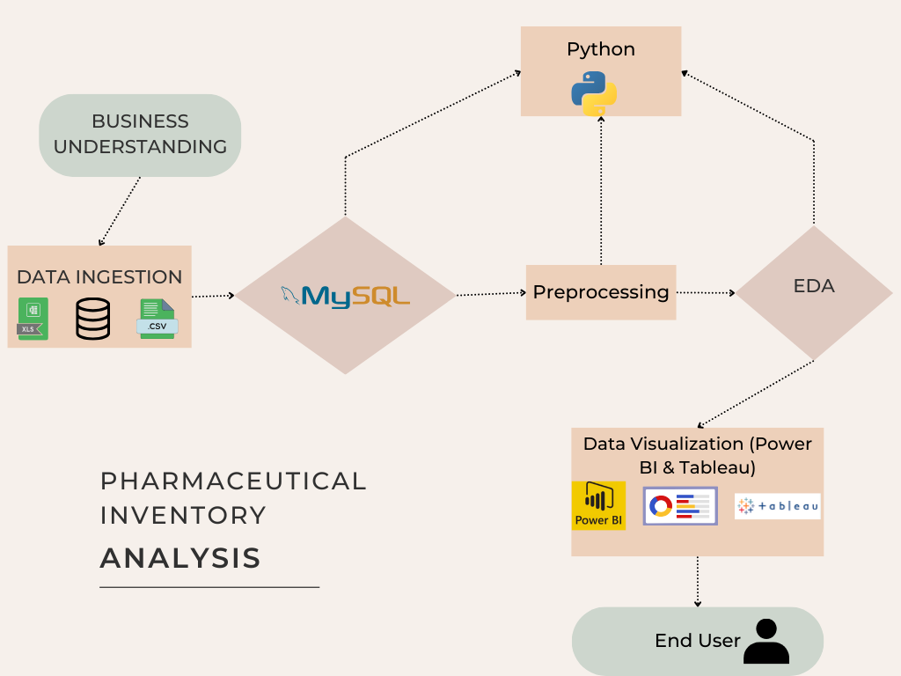
PROJECT ARCHITECTURE

Slide 7
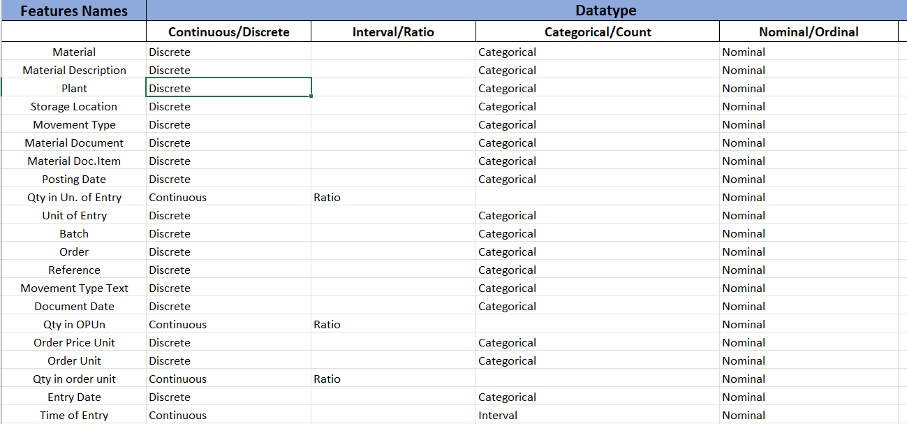
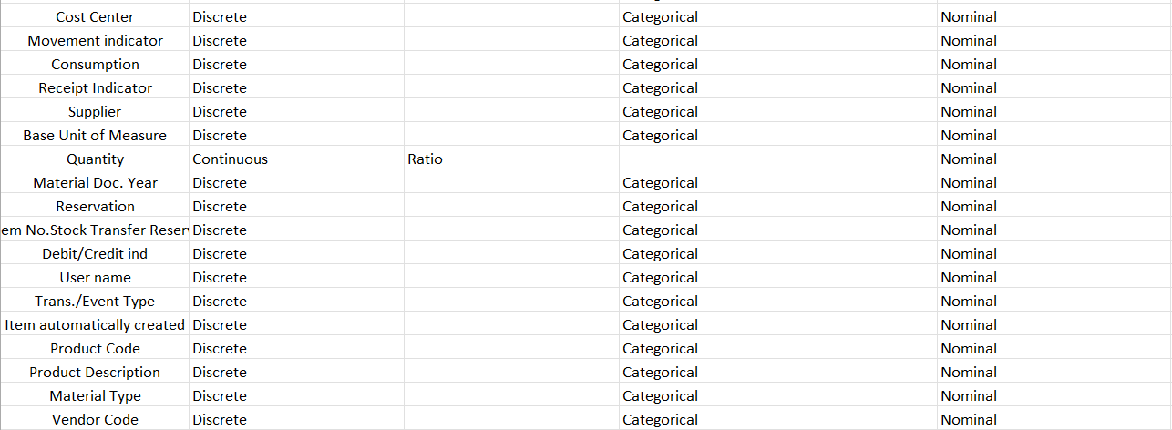
Data Dictionary

Slide 8
Exploratory Data Analysis [EDA]
Statistical Insights
Business Insights
Raw Data Dimensionality : 61,567 rows & 66 columns
After Cleaning the data, Data Dimensionality : 61,567 rows & 42 columns
Qty in Units of Entry: Mean: 3.42, Median: -1, Mode: -1, Skewness: -1.25, Kurtosis: 923.16
Qty in OP Units: Mean: 31.12, Median: 0, Mode: 0, Skewness: 36.17, Kurtosis: 1,456.78
Amount in LC: Mean: 5,813.51, Median: 0, Mode: 0, Skewness: 0.99, Kurtosis: 109
Qty in Order Unit: Mean: 31.12, Median: 0, Mode: 0, Skewness: 36.17, Kurtosis: 1,456.78
Quantity:
Mean: 3.42, Median: -1, Mode: -1, Skewness: -1.25, Kurtosis: 923.16
I have basically worked with 5 numerical attributes to perform EDA tasks, and those were :
Qty in Un. of Entry, Qty in OPUn, Amount in LC, Qty in order unit, Quantity
Data is slightly left skewed, with very high kurtosis
Data is highly right skewed with very high kurtosis
Data is slightly positive skewed (to the right)
Data is highly right skewed with very high kurtosis
Data is slightly left skewed, with very high kurtosis
Notes:
EDA is used for seeing what the data can tell us before the modeling task.
Change

Slide 9
Data Preprocessing
Statistical Insights :
Qty in Units of Entry: Mean: -0.32, Median: -1, Mode: 17.5, Skewness: -0.03, Kurtosis: -0.36
Qty in OP Units: Mean: 1.85, Median: 0, Mode: 0, Skewness: 1.22, Kurtosis: -0.19
Amount in LC: Mean: 1,550.13, Median: 0, Mode: 31,182.64, Skewness: 0.16, Kurtosis: -0.55
Qty in Order Unit: Mean: 1.85, Median: 0, Mode: 0, Skewness: 1.22, Kurtosis: -0.19
Quantity:
Mean: -0.32, Median: -1, Mode: -17.5, Skewness: -0.03, Kurtosis: -0.4
Business Insights :
Data is very slightly left skewed, considerably almost balanced now to be analysed
Data is slightly right skewed with almost balanced to be analyzed
Data is very slightly skewed towards the right
Data is slightly right skewed
Data is very slightly left skewed, considerably almost balanced now to be analysed, while the kurtosis values indicate that your data distributions are platykurtic, with fewer extreme values and lighter tails compared to a normal distribution.
Notes:
Keep observations

Slide 10
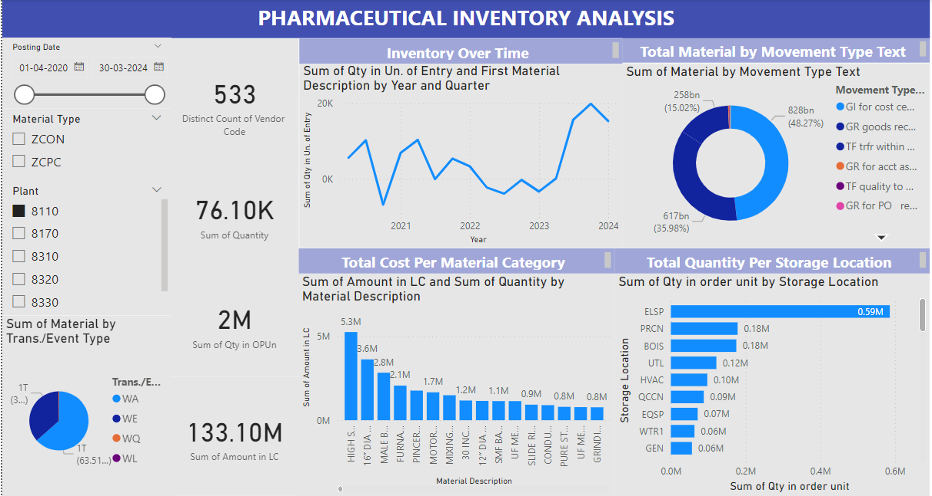
Data Visualization (Power BI Dashboard)
Notes:
Add graphical

Slide 11
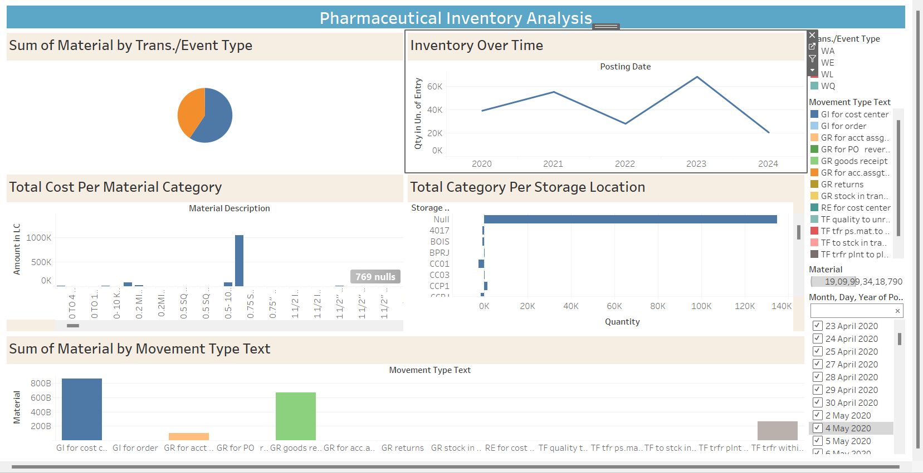
Tableau Dashboard

Slide 12
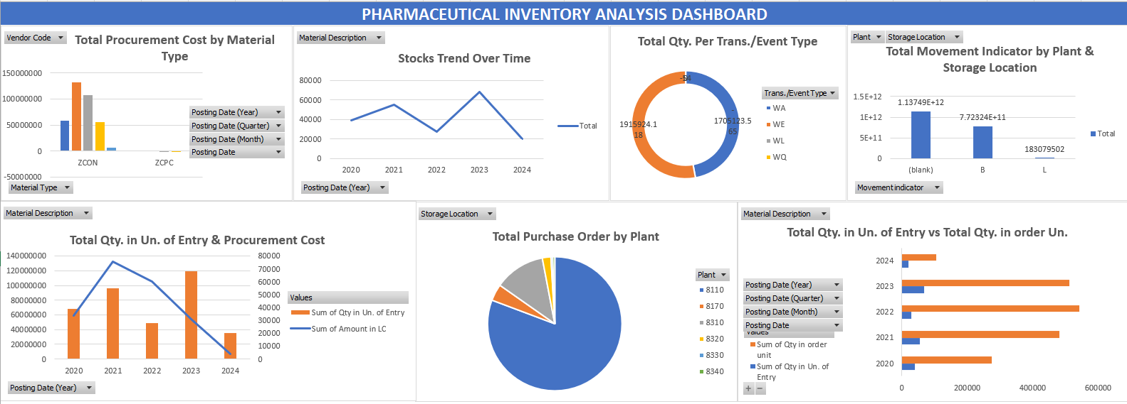
Advanced Excel Dashboard

Slide 13


